Slide 1
OOP
Seat Arrangement Program
Team 7
중앙대학교 컴퓨터공학부
박찬주
Leader 안준형
김종욱
김재형
안태원
유가람

Slide 2
Contents
Project Summary
How to compile and execute
Description on what functions are implemented -UML, Algorithm, GUI
How you implemented
How applied object oriented concepts
Conclusion
Execution result

Slide 3
Project Summary
This project is implemented for users who uses seat
Arrangement program by using coupling.

Slide 4
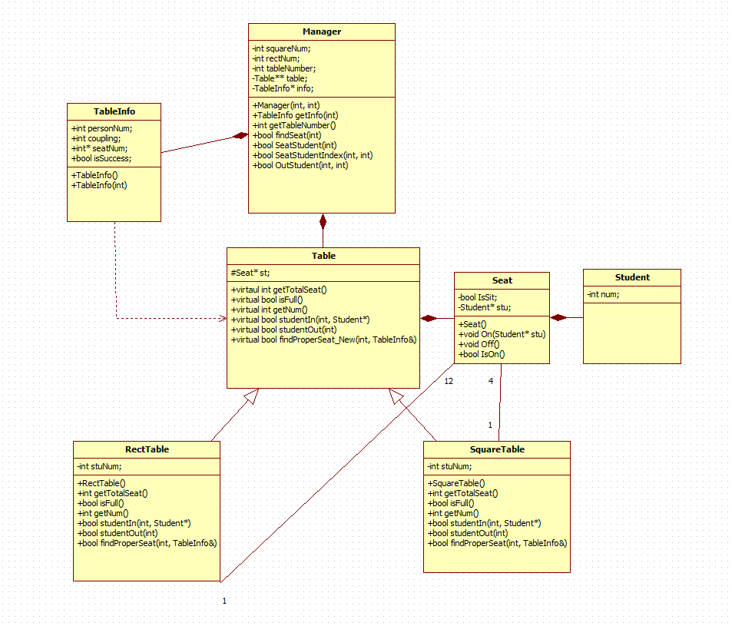
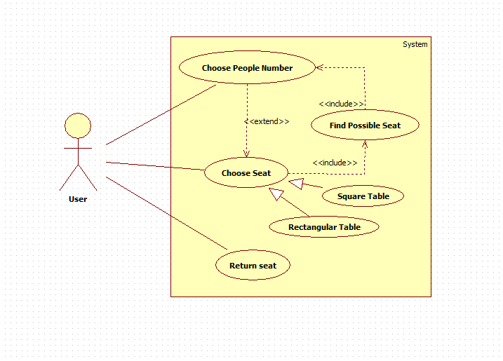
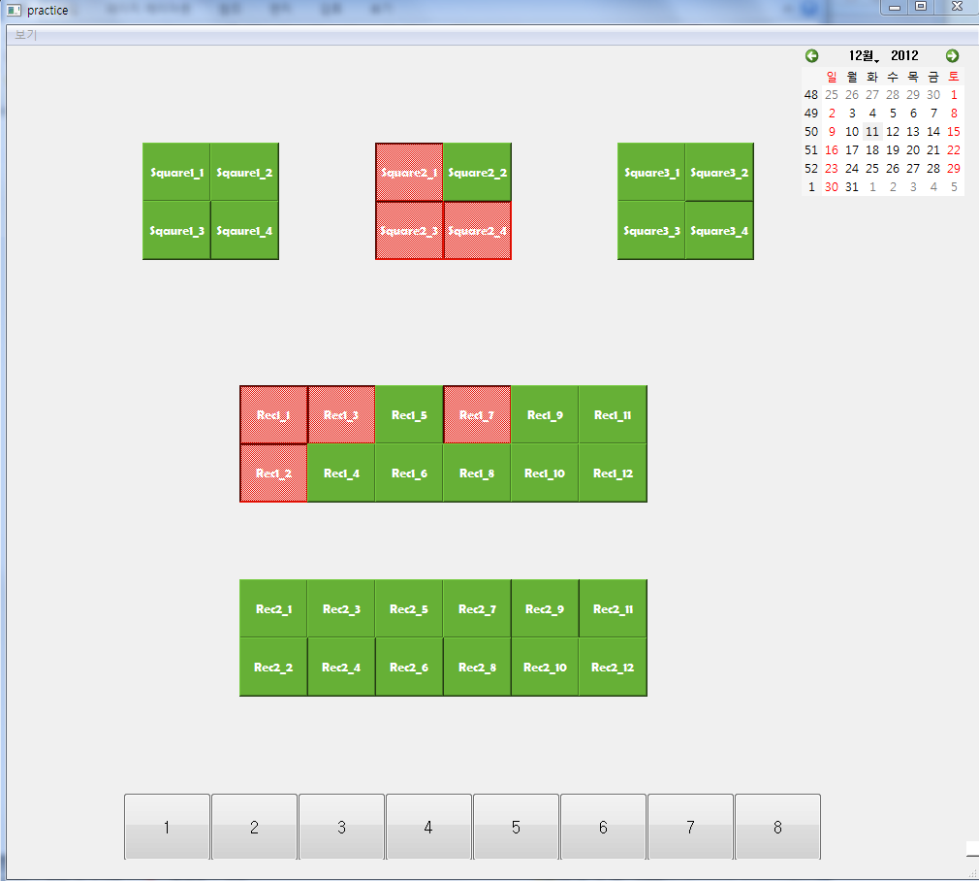

How to compile and execute
Execution

Slide 5
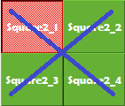
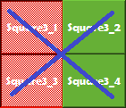
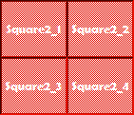
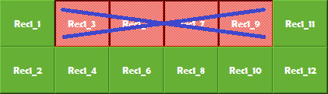
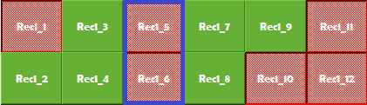
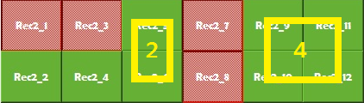
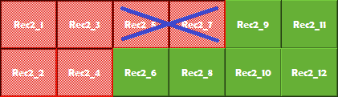
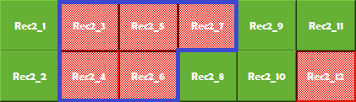
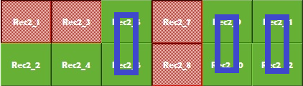
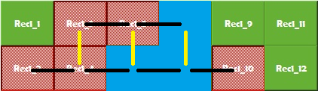
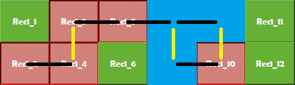
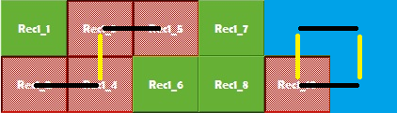
Description on what functions are implemented -Algorithm

Slide 6



Description on what functions are implemented -GUI
=>Basic Seat (available)
=>Filled Seat (unavailable)
=>Optimized Seat (available)
=>Input Number (1~8)

Slide 7
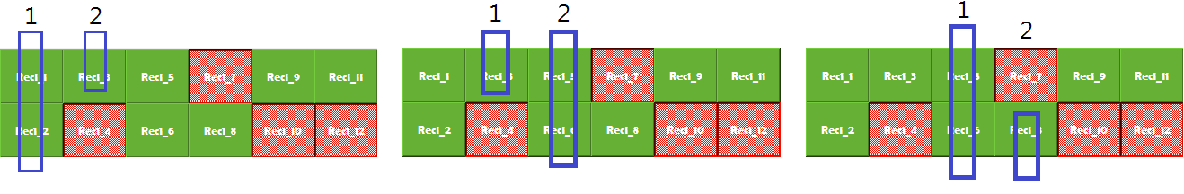
How you implemented
Algorithm

Slide 8
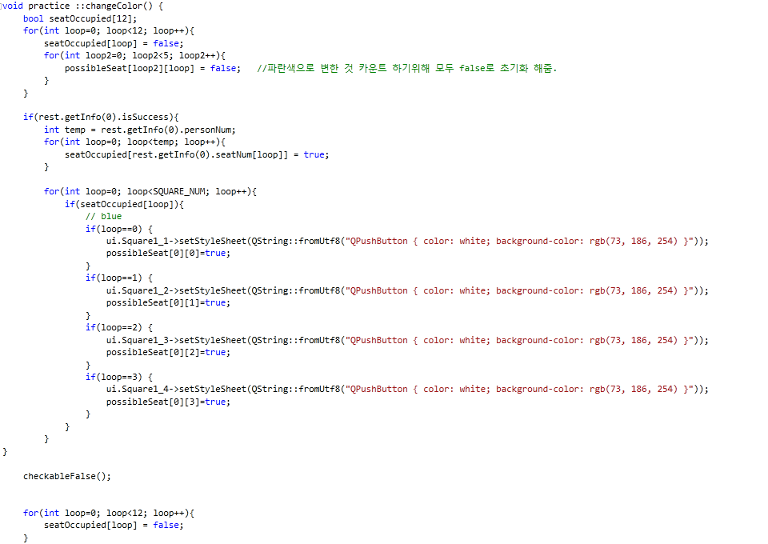
How you implemented
GUI

Slide 9
How applied object oriented concepts
Using...
Objectivation
Inheritance
Dynamic binding

Slide 10
Execution Result

